Slide 1
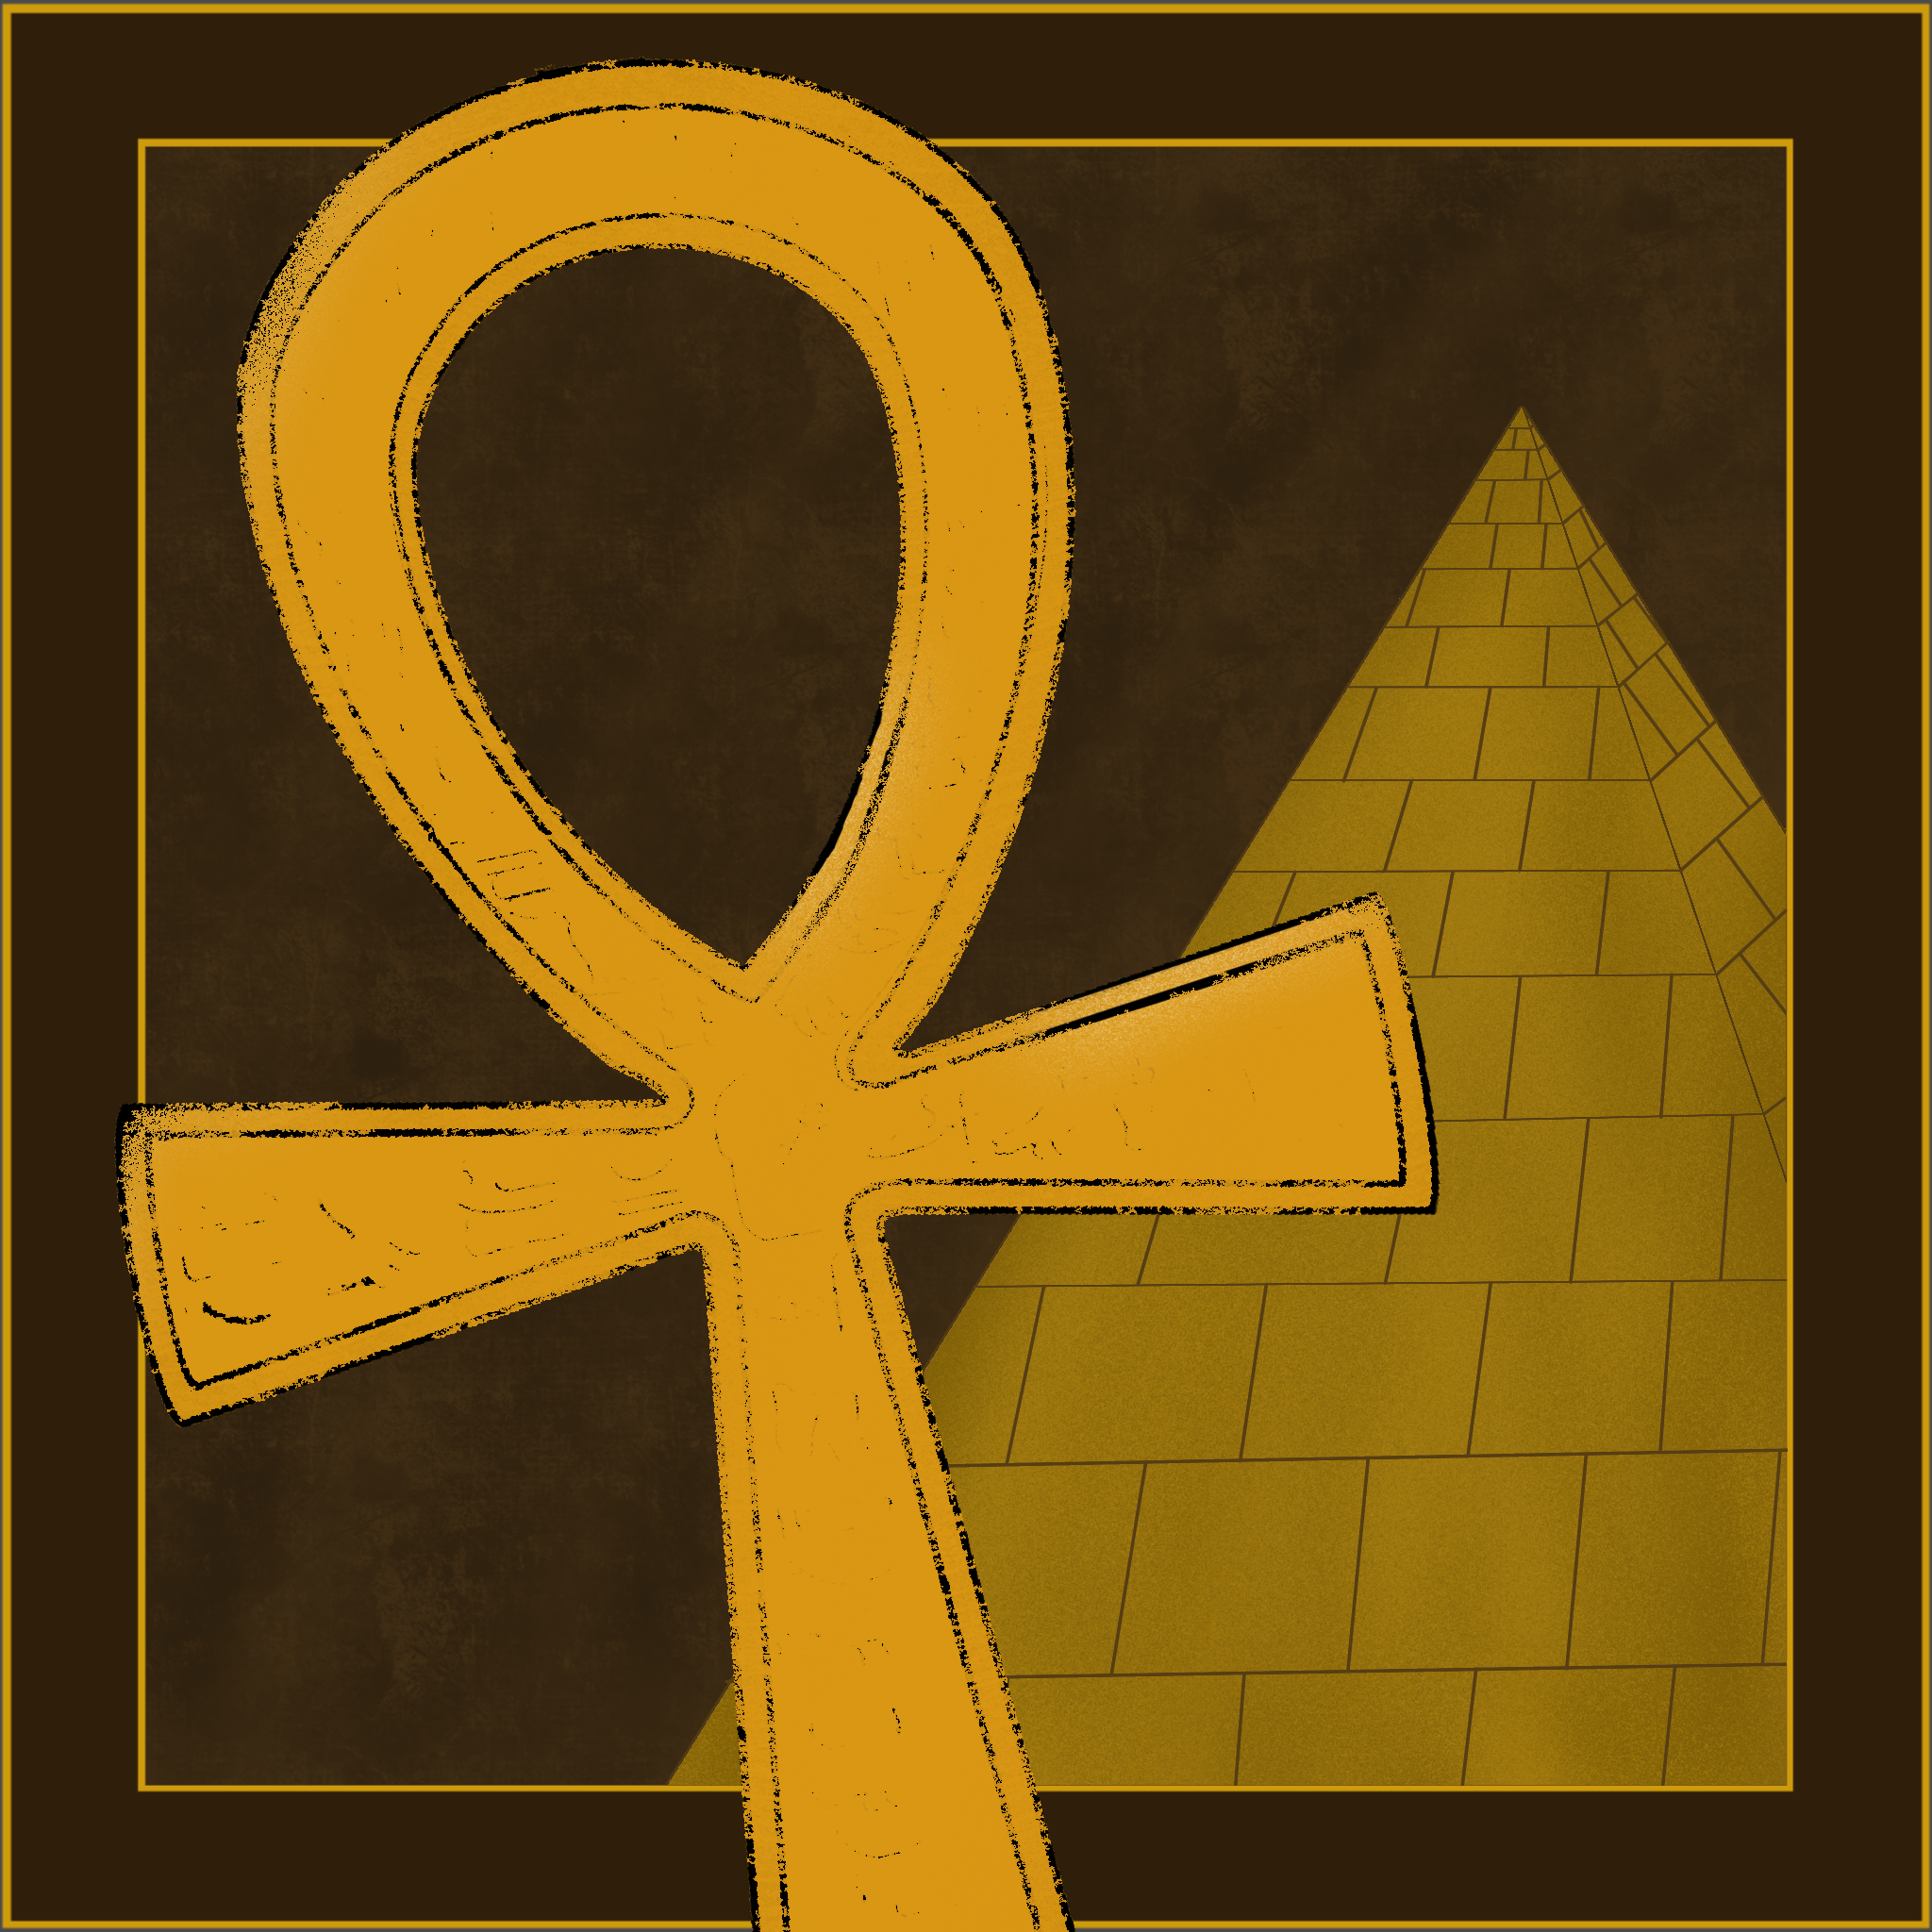
AnkhOS
J, Xavier, Nova

Slide 2

What is this project?
An information hub for Kemetic deities. There tends to not be very many places to find information that is concise, accurate, and detailed online. Our website is an attempt to remedy this.

Slide 3

Why did we choose this project?
The basic idea came from the fact that I (J) have an interest in Kemetism and practice in worship. The other team members just joined and said 'why not lol'
Kemetism is the worship of the gods and goddesses of ancient egypt

Slide 4
Live Demonstration!

Slide 5
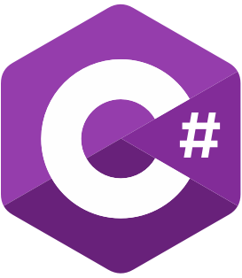

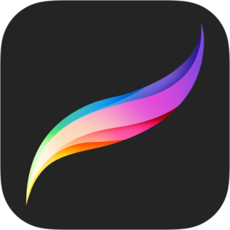
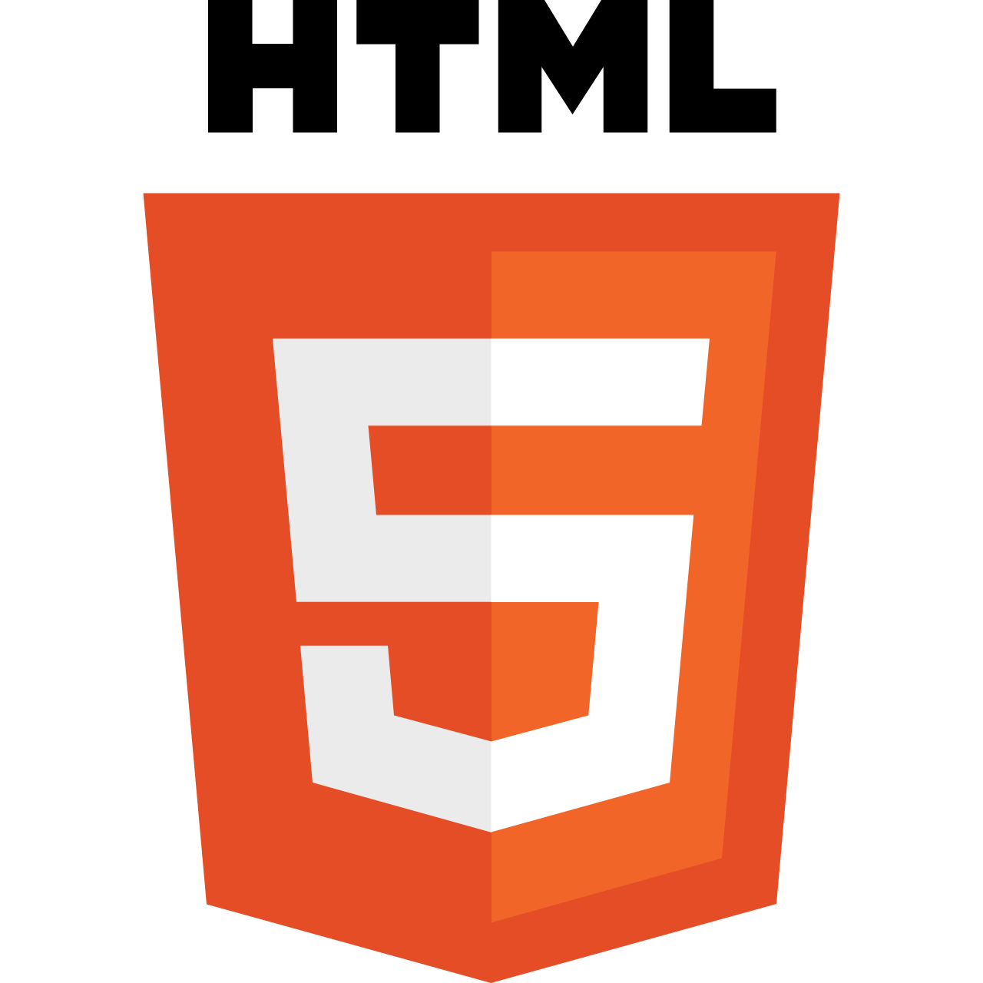


Technologies, Frameworks, Tools, Etc.
We used C# as our primary coding language, CSS/HTML for styling, Blazor for making it into a website, Procreate to design the logo and default profile picture, and GitHub to collaborate with the group

Slide 6
What went well?
What challenges did we encounter?
What didn't go as planned?
What Lessons did we learn?
What would we do differently if development continued?

Slide 7
Thank You!

